Slide 1
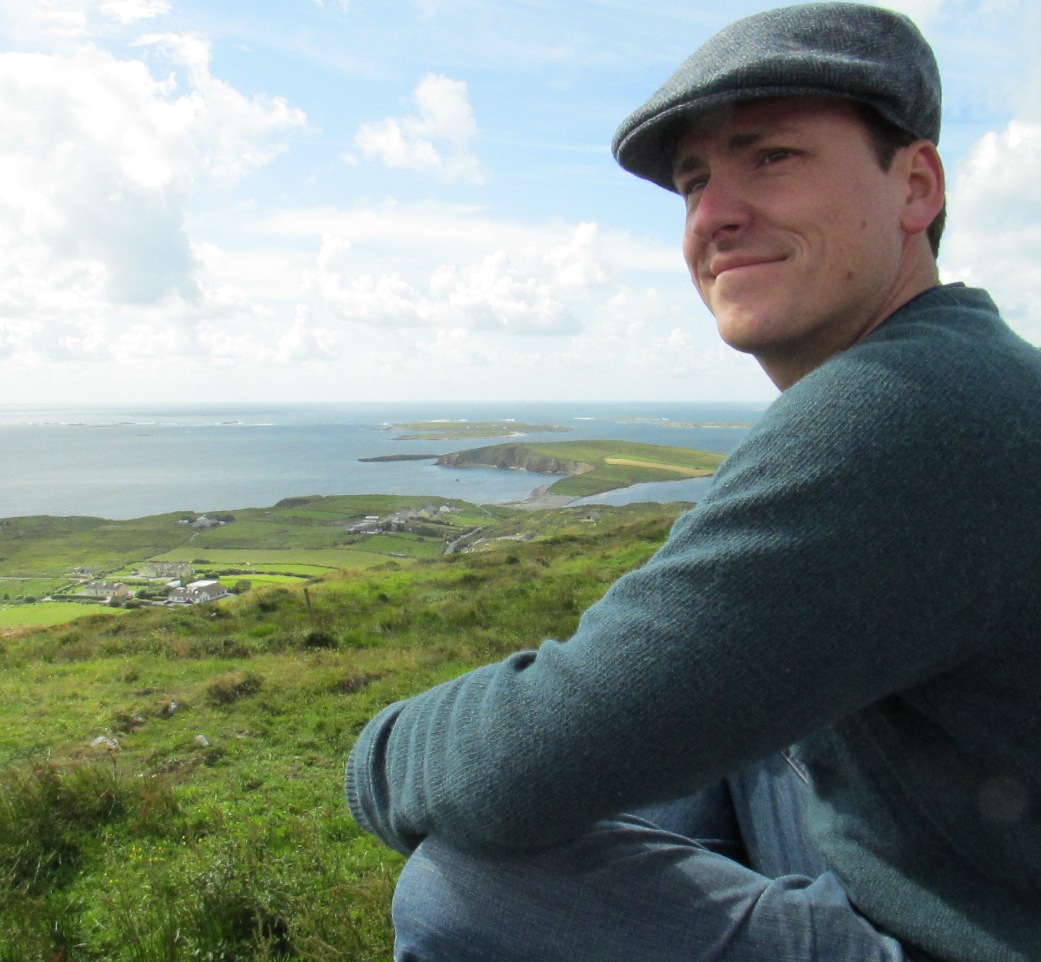
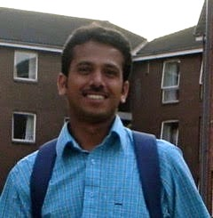
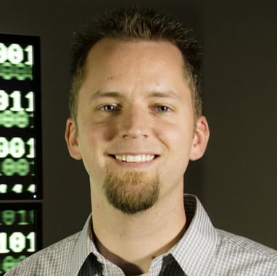


Journey to the Compute
Day 2: Compute Bound and Down, Container-ed Up and Truckin’
Based on work and publications by:
By: Blake Joyce
Upendra Devisetty
John Fonner
Tyson Swetnam

Slide 2
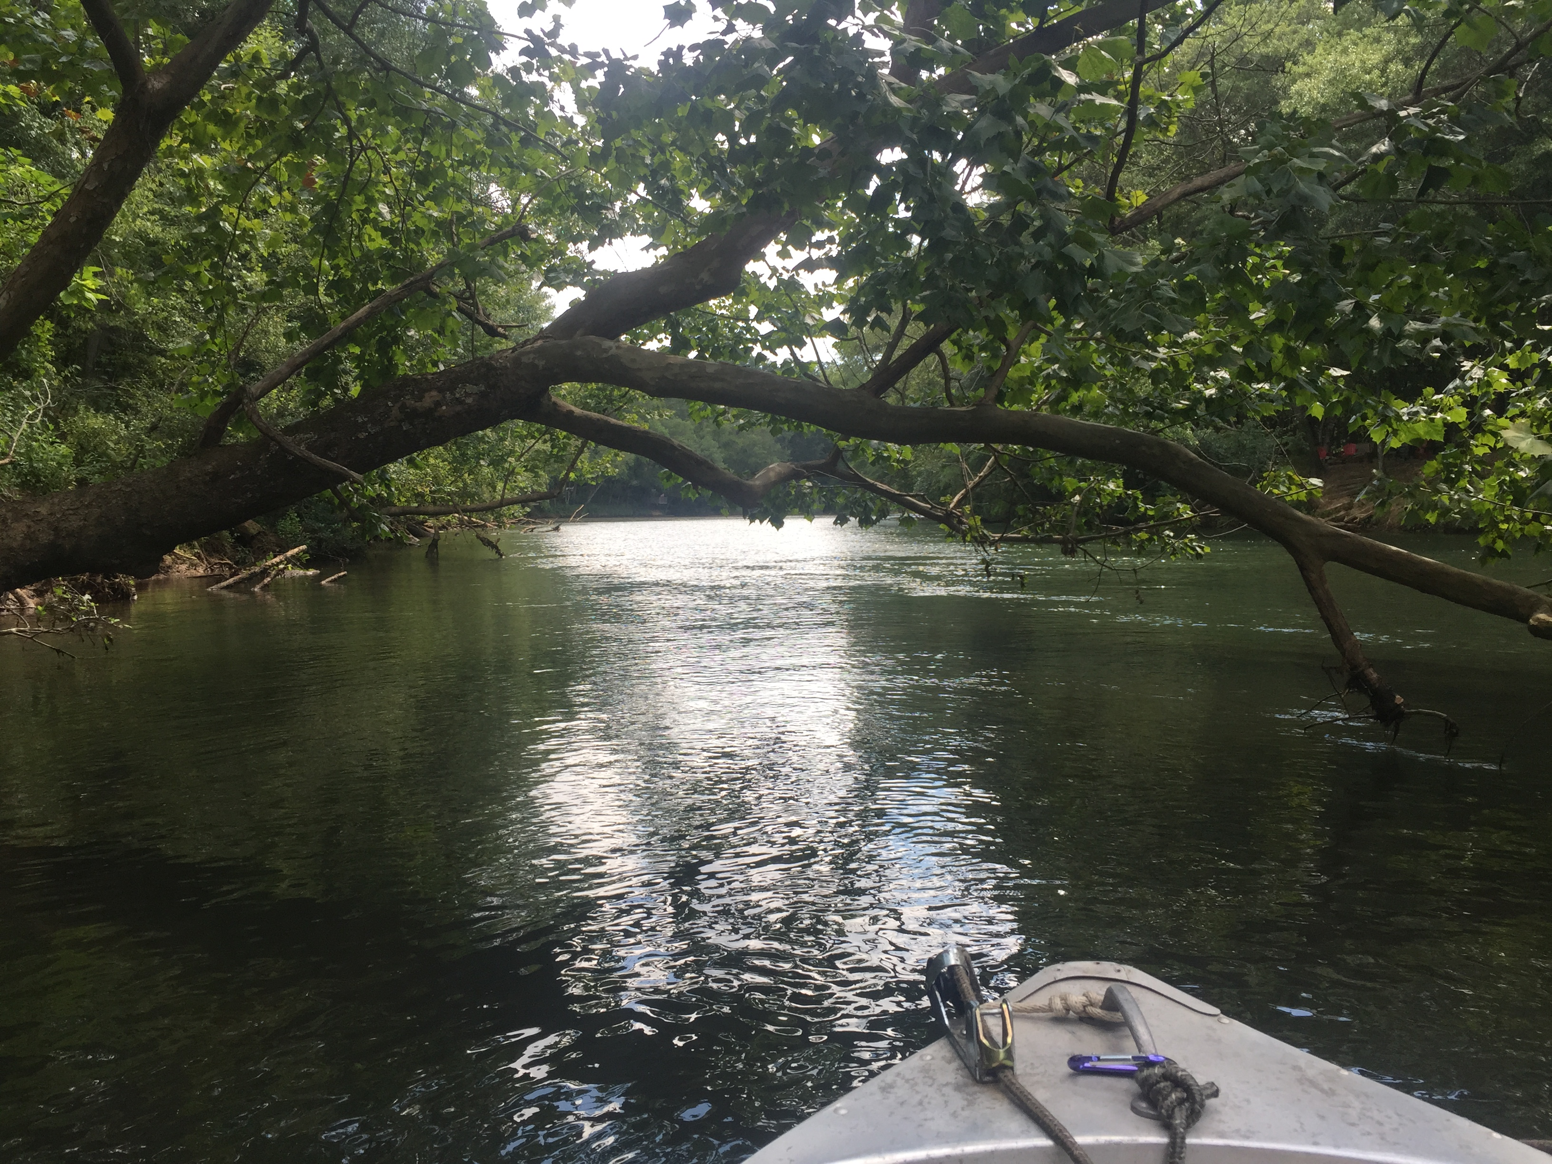
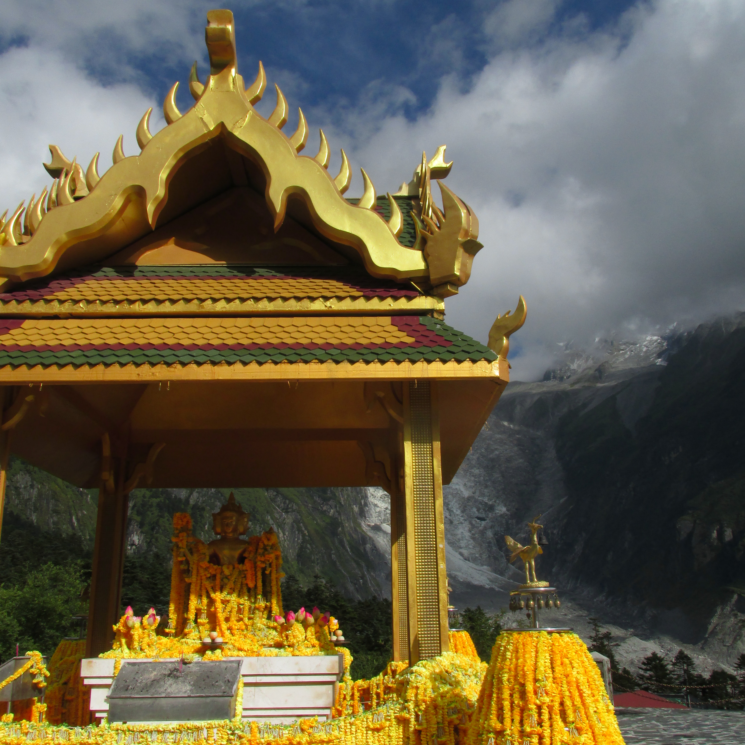
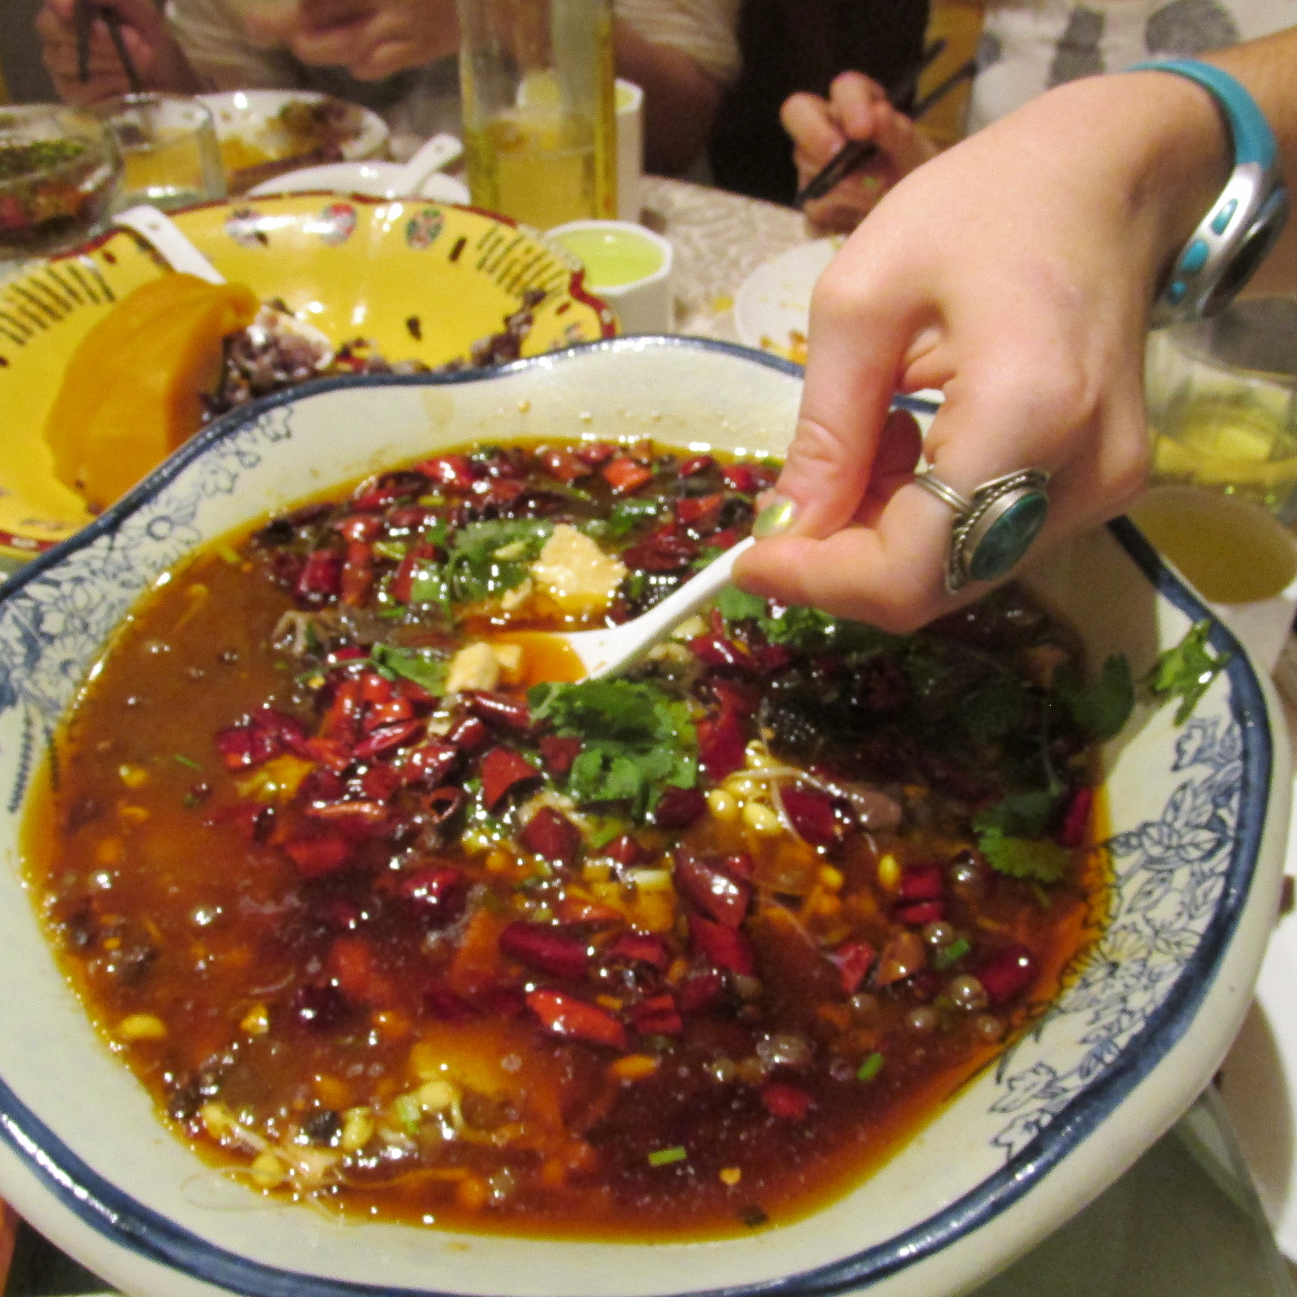
What We Are Really Interested In
FREEDOM!!! of compute resource choices
Easily leverage compute available
Wherever it may be
Because I want to live here
But work here
Get work done faster
HPC and Cloud Resources
Personal suggestion:
Use cloud for development
CyVerse Atmosphere: atmo.cyverse.org
Bioinformatic images available
`ez` install for several popular packages + dependencies
Move out to bigger compute through containers

Slide 3
Generalized Workflow
Here’s the standard thought process:
Local -> Docker -> Cloud
Local -> Singularity -> Cloud/HPC
Local -> Docker -> Singularity -> HPC
Reality: currently few prebuilt only Singularity containers for bioinformatics
Getting better though!

Slide 4
Introducing Singularity
Docker vs Singularity
Docker
Runs a daemon with root access
Singularity
Doesn’t have a daemon
Note: they’re developing a containerized daemon!

Slide 5
Moving out: Local Computer → Cloud
Workflow in CyVerse
Login to Atmosphere (user.cyverse.org)
Launch an instance through GUI
Set up Docker/Singularity using `ezd`/`ezs`
Test container(s) with example data for tool using `docker run`
Test container(s) small amount of your data using `docker run`
Modify container as needed
Get a bigger instance (Jetstream?)
Workflow Elsewhere
Login to a cloud service
Figure out OpenStack
Launch using OpenStack
Pull Docker/Singularity package
Install Docker/Singularity
Test container(s) with example data for tool
Pull data from storage onto instance
Test container(s) small amount of your data!!!
Modify container as needed
Upload all data on an instance with more compute resources
`docker run` with tested arguments

Slide 6
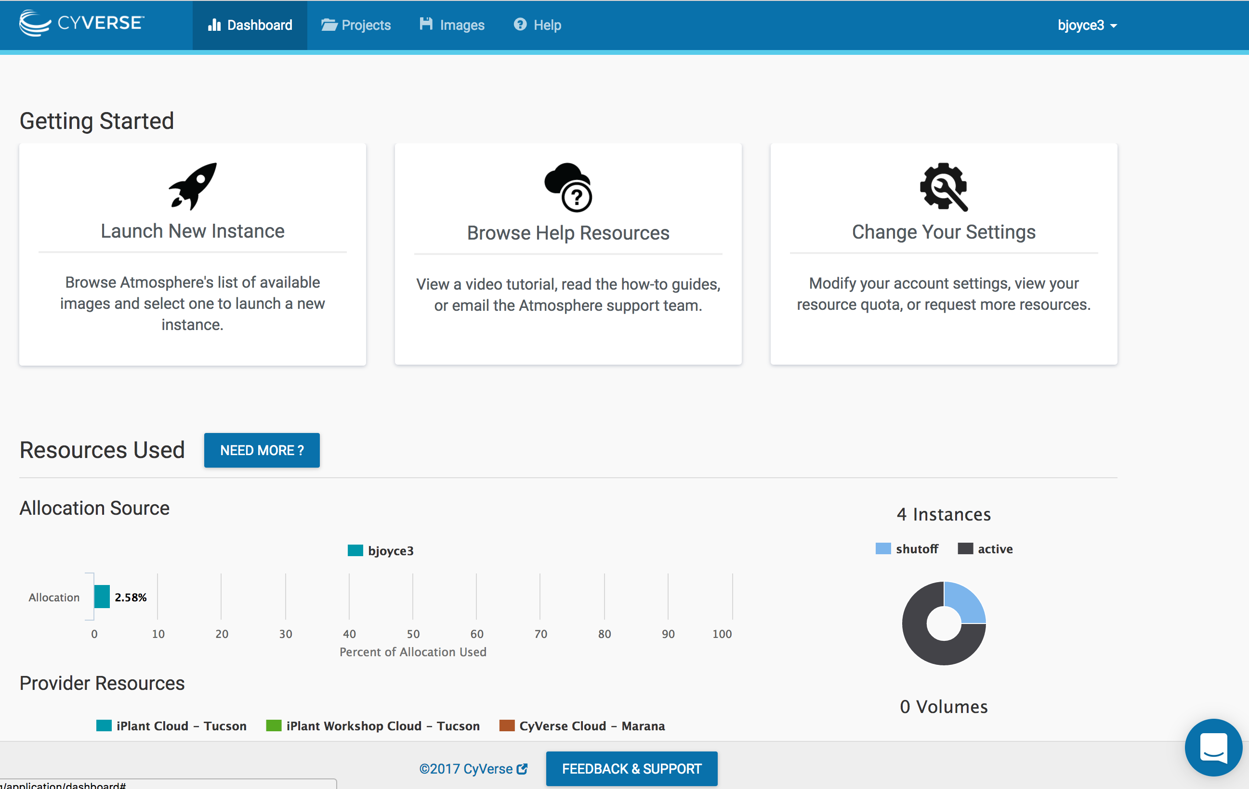
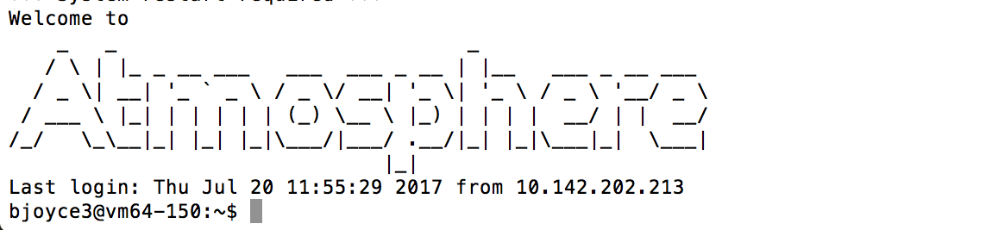
Local Computer → Cloud: Getting set up
Workflow in CyVerse
Login to Atmosphere (user.cyverse.org)
Launch an instance through GUI
Set up Docker/Singularity using `ezd`/`ezs`

Slide 7
Local Computer → Cloud: testing the container + data
Workflow in CyVerse
Test container(s) with example data for tool using `docker run`
Test container(s) small amount of your data using `docker run`
Modify container as needed
Get a bigger instance (Jetstream?)
Workflow Elsewhere
Test container(s) with example data for tool
Pull data from storage onto instance
Test container(s) small amount of your data!!!
Modify container as needed
Upload all data on an instance with more compute resources
`docker run` with tested arguments

Slide 9
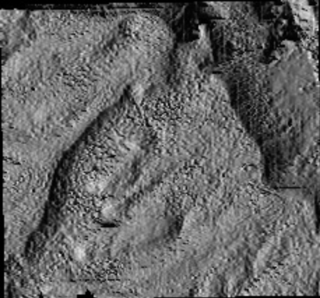
A Scale Problem: A Universe of Rays
GIS researchers have a lot of data
365 ‘daily’ outputs for solar radiation and hours of light (example →)
12 ‘monthly’ net radiation
Please note:
This is a mature container project
But this is what’s possible
We’ll talk about how to start your own journey afterward
Container == Singularity
Work by: Tyson Swetnam (UA, CyVerse)
Mats Rynge (USC, Pegasus)

Slide 10
One Way to Work at Scale: work queues
Typing/Seeing Screen on Local Computer
Atmosphere Instance
‘Master’
CCTools
CCTools
CCTools
CCTools
Singularity
Docker
Results
Results
UA HPC
Worker(s)
Atmosphere instance
Worker(s)

Slide 11
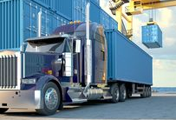
Let’s Get Crazy: a demonstration
Now we’re doing some real computational trucking
Typing/Seeing Screen on Local Computer
GIS tools: Grass, GDAL, Saga
CCTools
Atmosphere Instance
‘Master’
UA HPC
Worker(s)
Atmosphere instance
Worker(s)

Slide 12
Hybrid: Cloud → Cloud + HPC
Automated commands found on the GitHub repo
Path: Journey_to_the_Compute/DayTwo/Code/commands_to_copy_execute.md
This workflow utilizes CCTools (CCL Software Suite)
Makeflow to handle the distributed workflow system
Work Queue for Master-Worker job distribution
Notes:
Commands derived from Tyson Swetnam’s repos/repo wikis:
https://github.com/tyson-swetnam/sol-ot-comet-dev
https://github.com/tyson-swetnam/eemt-singularity-dev/wiki

Slide 13
Local Computer → UA HPC: starting the container
UA HPC Worker
All commands are in the Day 2 GitHub
Going to set up a ‘worker’ on the UA HPC
UA HPC worker will talk to Atmosphere Master
Singularity setup is automated
Communication and job handling automated with shell scripts!
CyVerse Atmosphere Master
All commands are in the Day 2 GitHub
Going to set up a ‘master’ on one Atmo instance to dole out tasks
Talks to all workers through the magic of CCTools
CyVerse Atmosphere Worker
All commands are in the Day 2 GitHub
Going to set up a ‘worker’ on an instance
Atmosphere worker will be effectively the same as the HPC worker
CCTools magic!

Slide 14
Planning Your Journey
Insights from the Road

Slide 15
In Short: Containers First
It’s really about the containers
Set them up
Test them
Keep them with your data for reproducibility
If you’re in the academic world:
Treat containers like a publication
The de facto ‘Methods and Materials’ for computational analysis
Treat containers like an analysis package
But remember there’s more to reproducibility
Analysis package + DATA
I haven’t seen many slick tricks for data ← working on this
“Keep them public, keep them safe” – Everyone but Gandalf

Slide 16
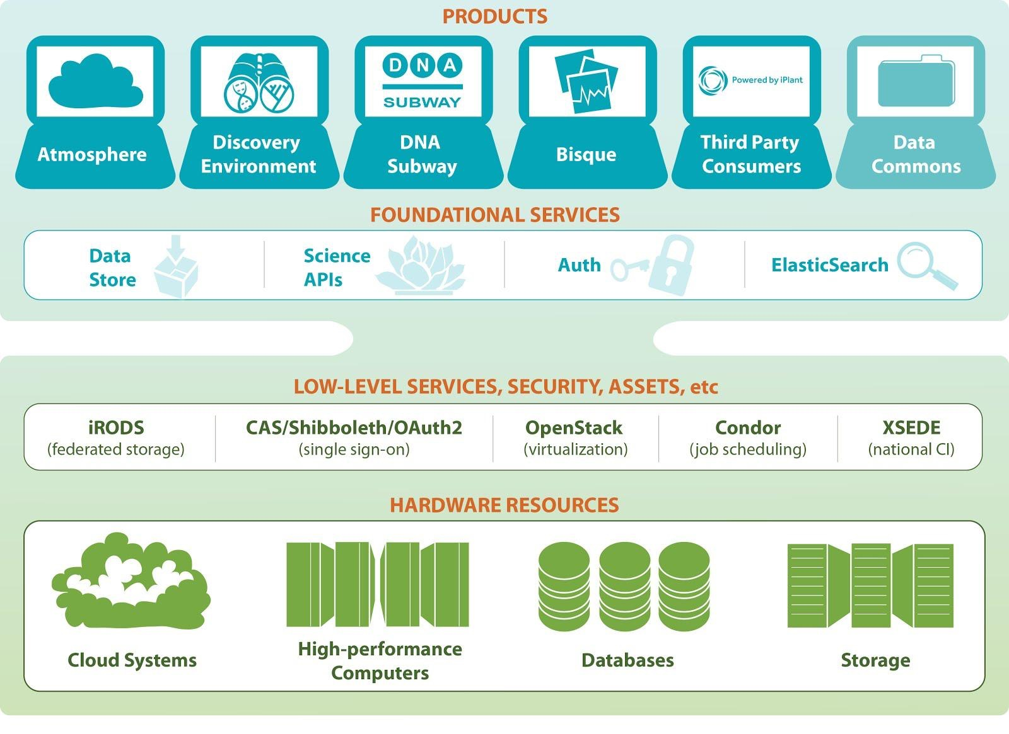
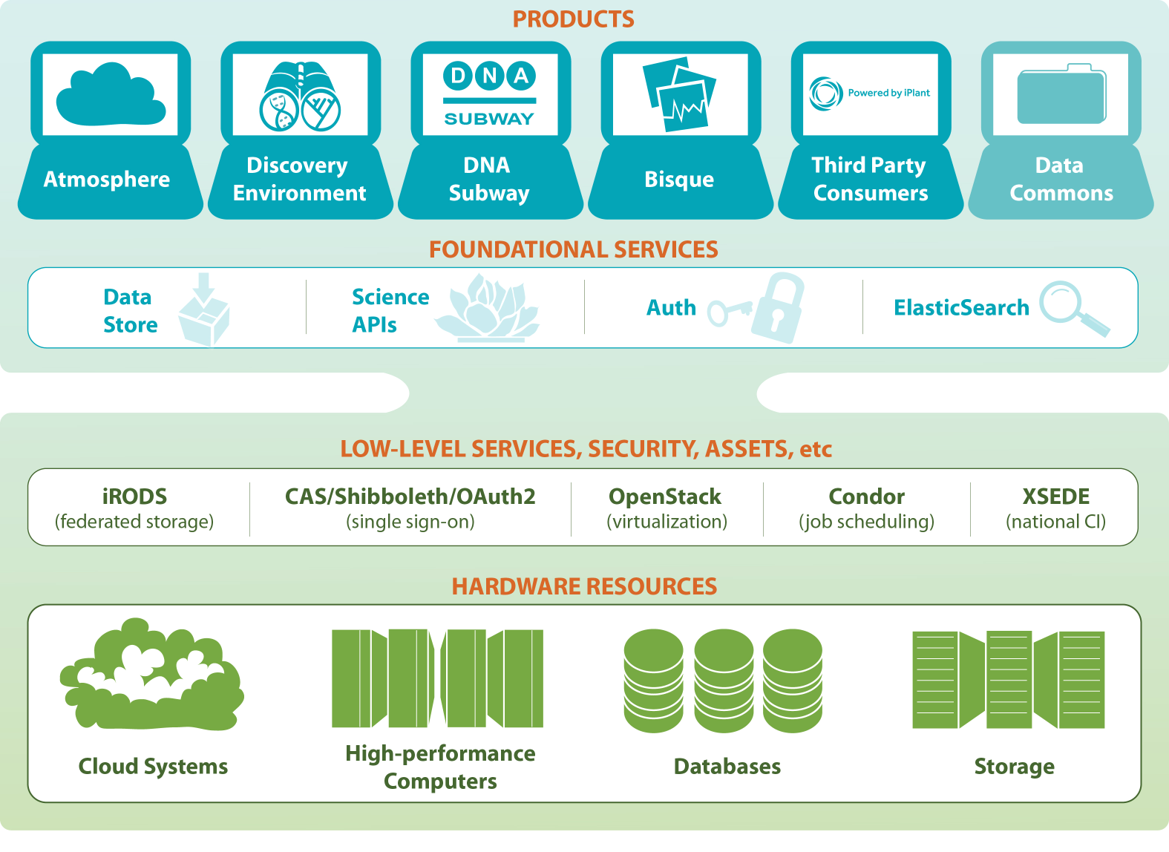
Products Overview
Atmosphere | User-provisioned, highly configurable cloud computing environment tailored for life sciences
Discovery Environment | Web-accessible analysis workbench and gateway to national HPC infrastructure (XSEDE)
Bisque | Software for managing, analyzing and visualizing high throughput imaging data
Data Store | Scalable data storage for managing and sharing data across CyVerse’s CI and external data resources
Science APIs | Automation interfaces to connect data and computation for rapid integration with external resources. Also used as a graduate teaching platform.
DNA Subway | Classroom-friendly bioinformatics teaching platform
Powered by CyVerse | Third-party applications built on CyVerse’s foundational services and infrastructure

Slide 17





Managing the Data Life Cycle
Data Commons
Metadata Markup
Search and Discover
Share/Collaborate
Publish
Transfer
Visualize
Store
Analyze
Reuse
Discovery Environment
Bisque
Data Store
Atmosphere
Science APIs
Notes:
Requires BEST PRACTICES AND PROPER INFRASTRUCTURE
Managing and empowering each aspect of the life cycle is probably the way we view our mission from a holistic and user focused perspective.

Slide 18
Roll Your Own Container
Docker
Login to a cloud instance
(my preference)
Pull down dockerfiles
Edit and include new packages
Denote versions of everything
Define an `ENTRYPOINT`
(This makes docker2singularity work better)
Build the container locally
Tag the container
Push up to DockerHub
Run from wherever
Singularity
Login to a cloud instance
(my preference)
Set up a Singularity container
singularity create centos7.img
Layer in Docker containers (optional)
singularity pull docker://centos:latest
You can shell in the container
singularity shell centos7.img
From TACC: docker2singularity
(Helps Windows users!)
It’s not feasible to go over this in a workshop format, but…..

Slide 19

Have I Plugged Research Bazaar Events Yet?
There’s also
Shut Up & Write
Fridays
8:00-10:00
UA iSpace
Science & Engineering Library

Slide 20
(Rough) Guide to Scientific Compute
Additional storage = Volumes
Storage close on machine
Flexibility
(Scale, Env Mods)
Always plan to fail
(backup everything always)
Specialty Compute
(GPU, high mem, etc.)
Cloud
Usually easier to get
tons of compute
HPC
Easier work_queue
setup?
Easy to Distribute uniform environment
(classes, workshops)
Sometimes ~free
for academics
AKA Ghost computer, ether computer
This is what an HPC looks like in my mind

Slide 21




CyVerse
Nirav Merchant
Eric Lyons
Matt Vaughn
Doreen Ware
Dave Micklos
The CyVerse Executive Team
Funded by the US National Science Foundation
DBI-0735191 and DBI-1265383
Notes:
Focus here is on genomics data, but not restricted to genomics data

Slide 22
Project Growth

Slide 23
Publications Acknowledging
Use of Cyverse

Slide 27
Journey to the Compute
Day 2: Compute Bound and Down, Container-ed Up and Truckin’
Based on work and publications by:
By: Blake Joyce
Upendra Devisetty
John Fonner
Tyson Swetnam

Slide 28
Let’s get to it
Opening syntax statement for command line things
Commands are encircled by `some command here`
Don’t actually type the first `, or the second `
Other things to change are <circled by these>
Likewise: don’t type this <, or this >
Bonus points: Use tab to autocomplete things like long paths
I’d start by cloning my GitHub repo:
Open your terminal/shell/bash/cigwin/whatever
cHANGE dIRECTORY to your desktop
Mac command: `cd` /Desktop/
git clone the repo
git clone https://github.com/bjoyce3/Journey_to_the_Compute
Seriously! Go For It! Yeah, right now!

